Slide 1

Sound Pressure Distribution Measurements in an Acoustic Box
By: Todd McKenzie

Slide 2

AGENDA
INTRODUCTION
Acoustic Simulation
Experimental
Findings
Conclusions

Slide 3
Introduction
The goal of the experiment is to measure how different material types affect sound being block from exiting a box. The materials tried included cork and paper board. We tried increasing the number of layers which affected sound pressure levels with varying results. Absorption was also placed in the box to test how well it performed at reducing noise.

Slide 4
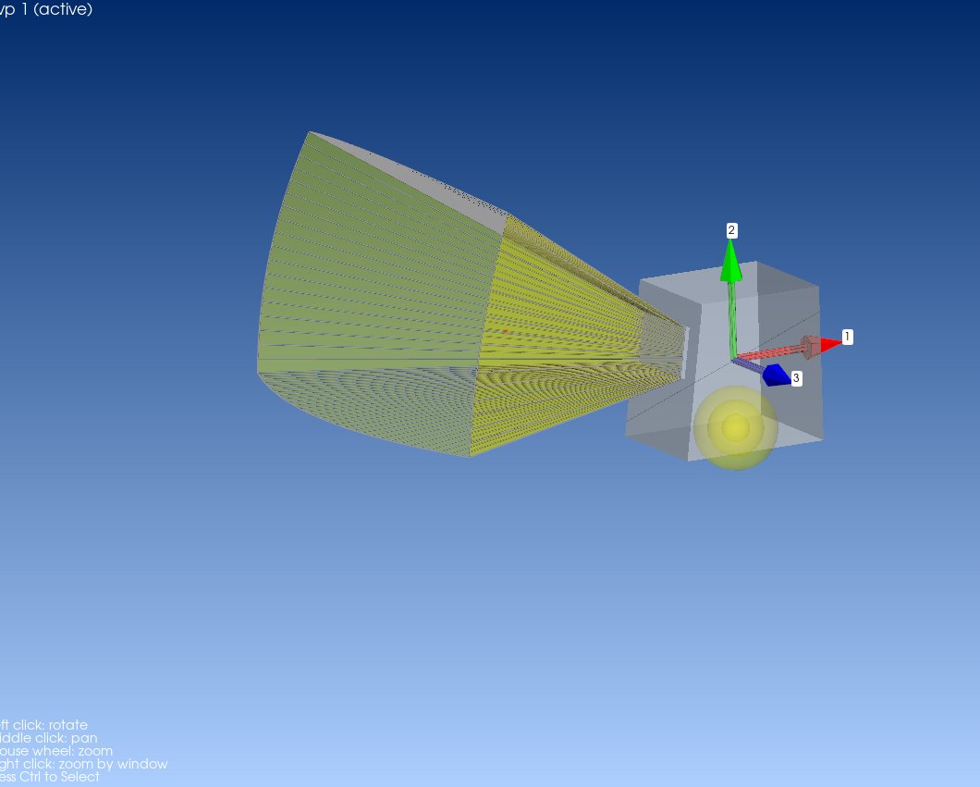
Acoustic Simulation
Monopole Setup:
The monopole is defined as the 2446H/J Compression Driver.
Infinite Acoustic Source:
The infinite acoustic source is defined where is radiates out of the face of the box.
Microphone:
A microphone is defined 1m away from the box.

Slide 5
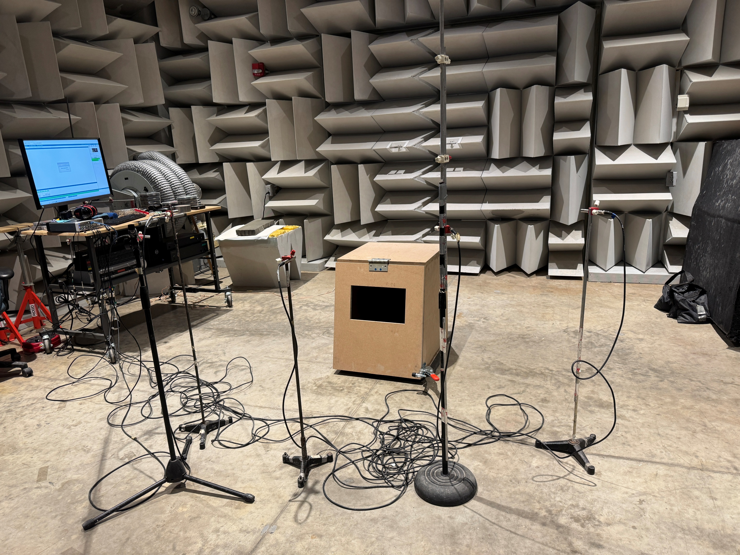
Experiment
Compression Driver Setup:
The compression driver was placed in the center of the box where it radiated sound outward
Microphones:
Three microphones were set up, each placed 1m away from the box.
Absorption:
Depending what we were testing absorptive foam was placed in the box.
Covers:
Cork or paper was placed over the exit of the box. This was to test how much impact covering the opening like this made

Slide 6
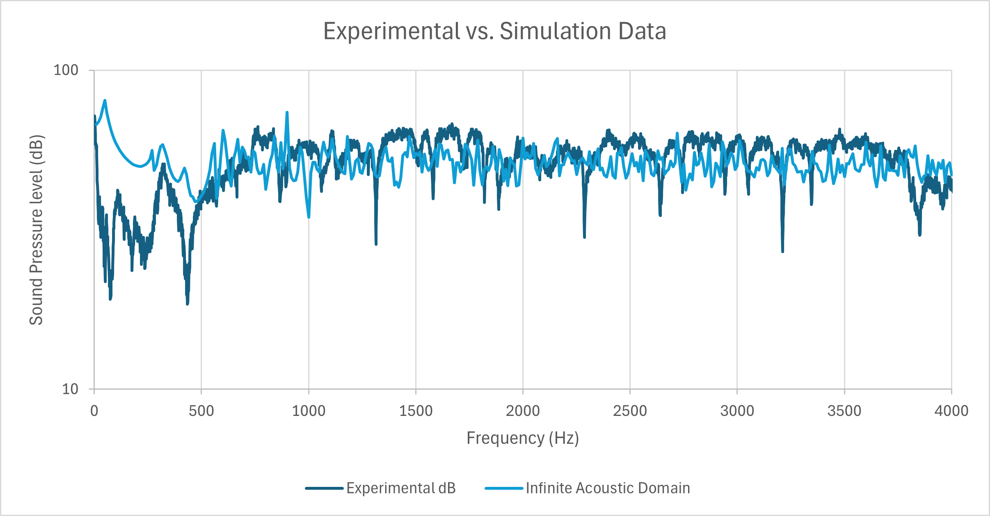
Findings
Experiment vs. Simulation:
We found that at frequencies 0 Hz to 500 Hz the data does not align. This makes sense because the compression driver is rated for 500 Hz to 20 KHz.
At frequencies 500 Hz to 4000 Hz, we can see some general trends where the data aligns at similar sound pressure levels.

Slide 7
Conclusions
We found that the acoustic simulations closely align with our experimental set up. Further acoustic simulations will be needed to confirm the results of the experiments. Further experiments may need to be done as well to further fine tune results.

